Slide 1
Offer Letter Generator
Team 2:
Jivitesh R – Hareebaalaji Muthukumar – Reddy Purandhar
Sanjith S – Ranjith Kumar S – Nithishkumar

Slide 2
Problem Statement
In today’s fast-paced recruitment landscape, timely communication with potential candidates is crucial. However, drafting personalized offer letters can be time-consuming and error-prone. Organizations need a streamlined solution to generate professional offer letters quickly and accurately.
The proposed website generates customized offer letters automatically by retrieving data from the database/table.
This ensures compliance, accuracy and saving time and resources.
Such a system would empower recruiters, enhance candidate experience, and expedite the hiring process. Implementing an offer letter generator can significantly impact recruitment efficiency and candidate satisfaction.

Slide 3
Product Backlog
REQ ID | SHORT DESCRIPTION | FEATURE OWNER
R1 | Login and Signup page – Frontend & Backend | Jivitesh
R2 | Login and Signup – Authentication and DB | Jivitesh
R3 | PDF Generation – Frontend & Backend : Sprint1 | Haree and Purandhar
R4 | PDF Generation – Frontend & Backend : Sprint2 | Haree and Purandhar
R5 | Exception Handling and Contact Us Page | Nithish
R6 | CSV Uploader Logic and About Us Page | Sanjith
R7 | Signup Validation | Ranjith

Slide 4
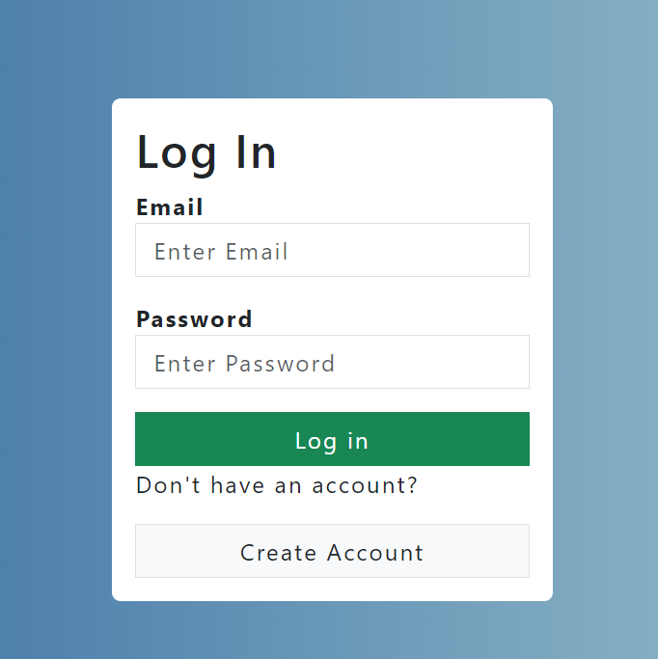
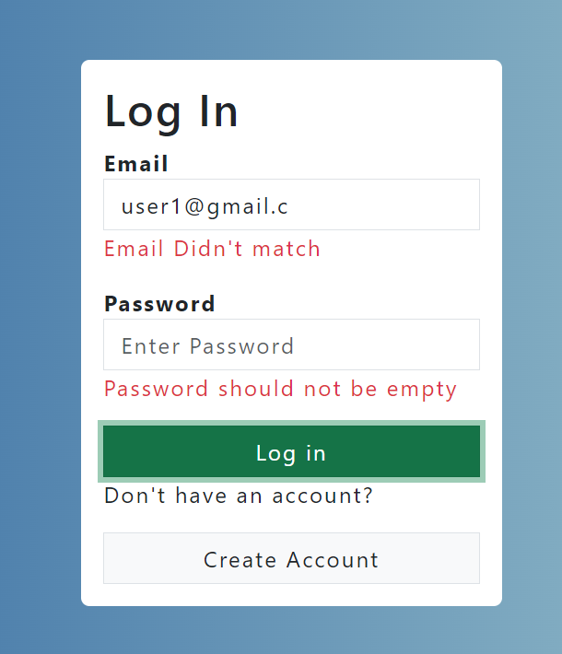
Login page with React Authentication
SCREENSHOTS OF EXECUTION

Slide 5
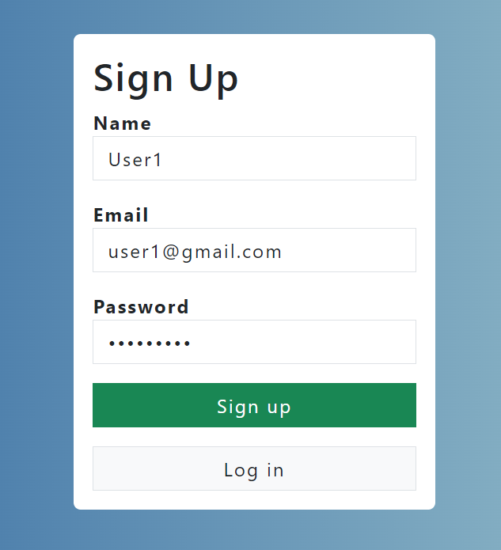
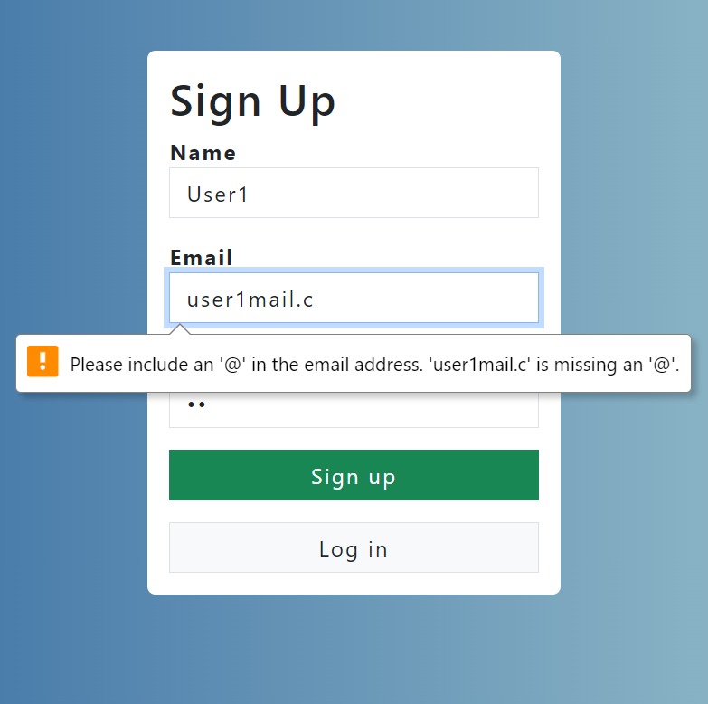
Signup Page - Validation
SCREENSHOTS OF EXECUTION

Slide 6
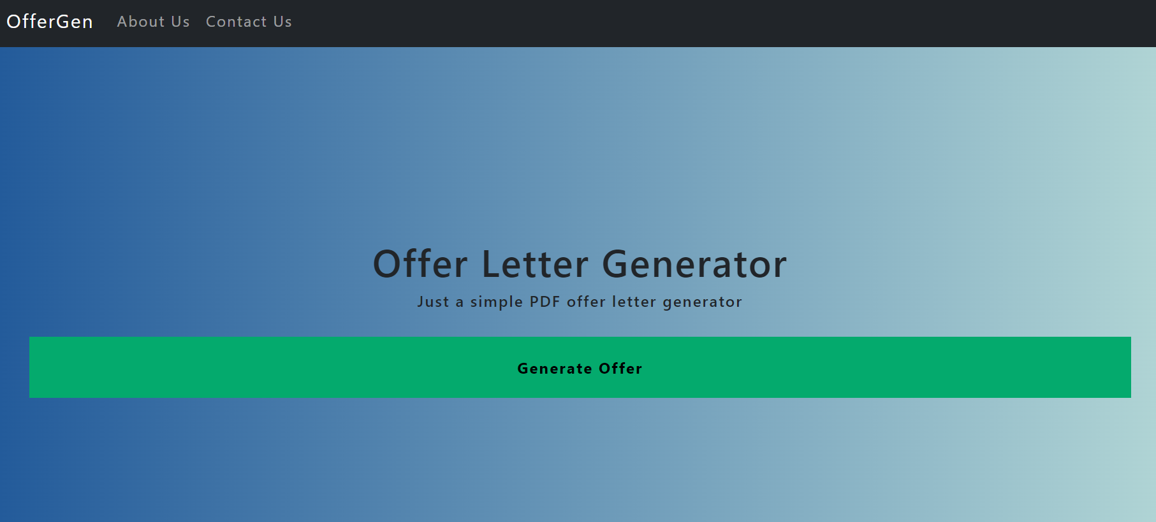
Home Page
SCREENSHOTS OF EXECUTION

Slide 7
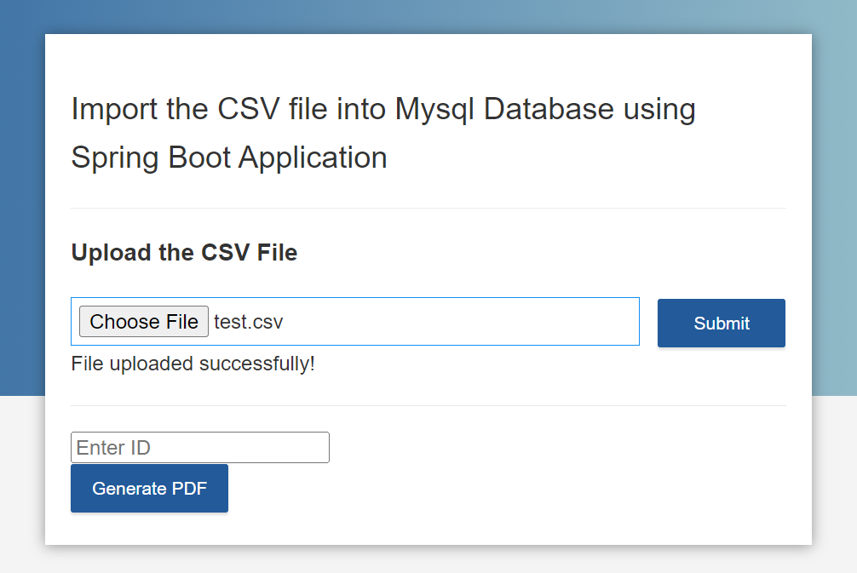
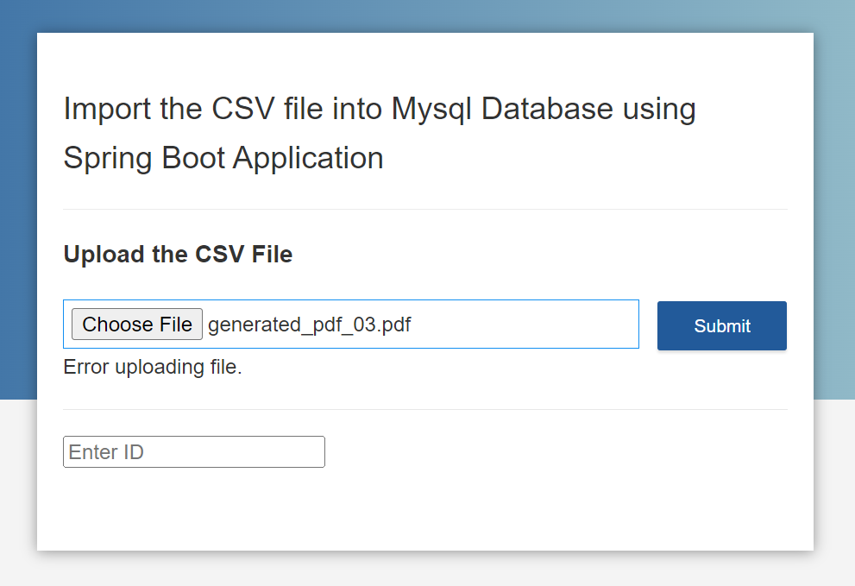
Offer Letter Generator
SCREENSHOTS OF EXECUTION

Slide 8
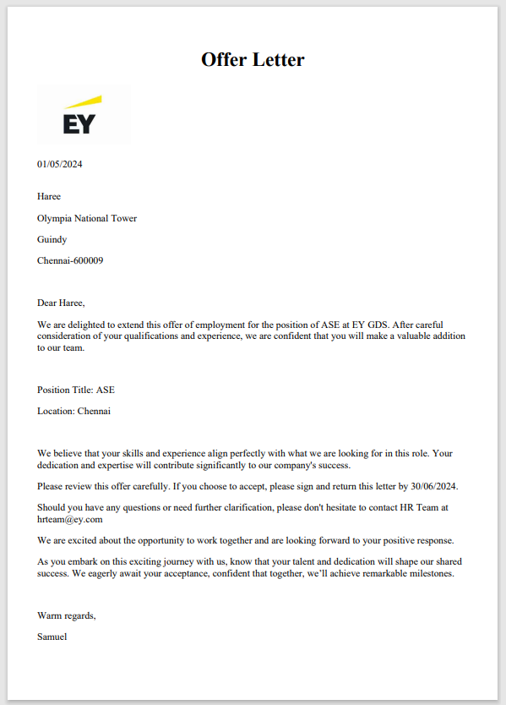
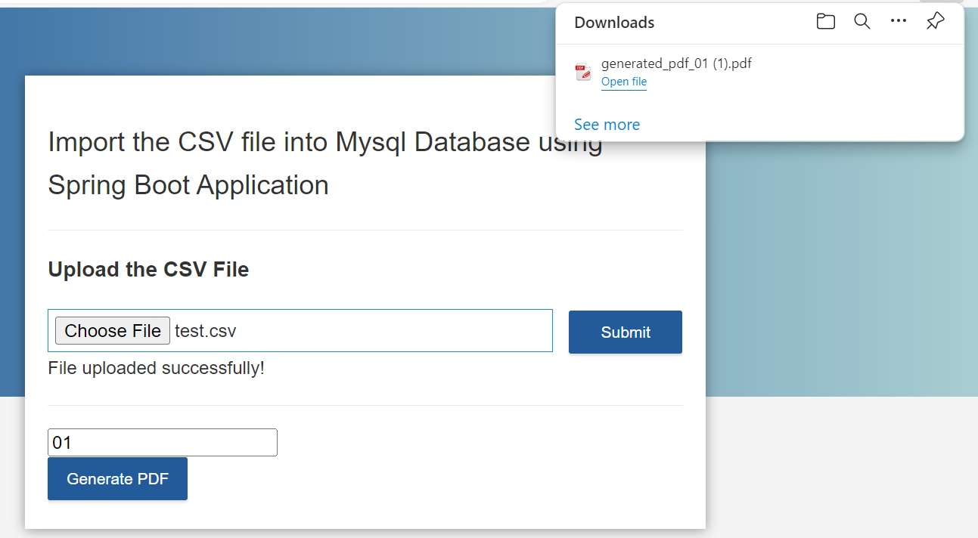
Offer Letter PDF download
SCREENSHOTS OF EXECUTION

Slide 9
Future Scope of the Project
Integration with Application Tracking Systems
Multi-Language Support
Ability to Share the pdf via socials
Integration with E-Signing Platforms
Ability to access previous versions of the offer letter.

Slide 10
Thank You
Team 2:
Jivitesh R – Hareebaalaji Muthukumar – Reddy Purandhar
Sanjith S – Ranjith Kumar S – Nithishkumar

